Slide 1
Final Project
Alejandro C Parra

Slide 2
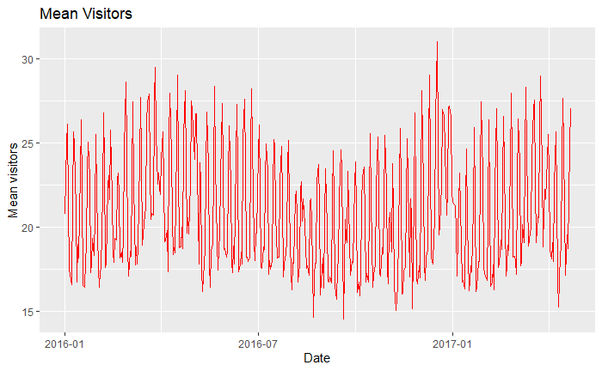
Mean Visitors

Slide 3
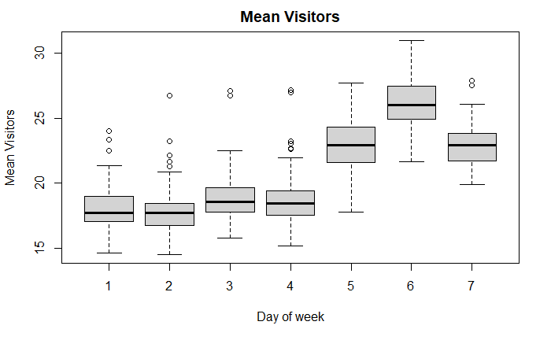
Mean Visitors

Slide 4

Types of Models
Linear Regression
Multiple Linear Regression
ARIMA
Dynamic Harmonic regression

Slide 5

Models tested
TSLM(visitors ~ trend() + season())
TSLM(visitors ~ trend() + season() + day_of_week + holiday_flg)
TSLM(visitors ~ trend() + season() + total_reserve)
TSLM(visitors ~ trend() + season() + air_genre_name)
TSLM(visitors ~ trend() + season() + na_val)
TSLM(visitors ~ trend() + season() + na_val_cumulative)
TSLM(visitors ~ trend() + season() + day_of_week + holiday_flg + air_reserve_visitors + hpg_reserve_visitors + total_reserve + na_val + na_val_cumulative)

Slide 6
Models tested
ARIMA(visitors)
ARIMA(visitors ~ total_reserve)
ARIMA(visitors ~ day_of_week + holiday_flg)
ARIMA(visitors ~ day_of_week + holiday_flg + total_reserve)

Slide 7
Models tested
ARIMA(visitors ~ fourier(K=1))
ARIMA(visitors ~ fourier(K=2))
ARIMA(visitors ~ fourier(K=3))

Slide 8
Results

Slide 9
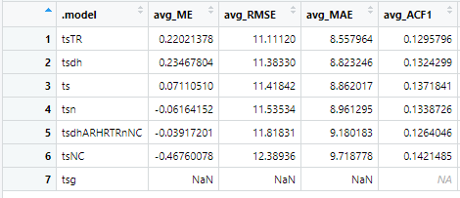
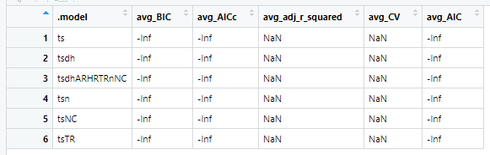
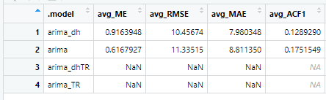
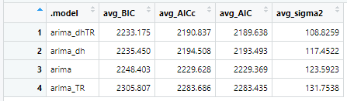
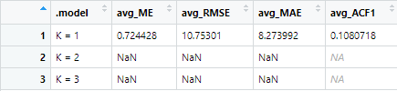
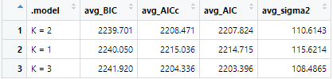

Slide 10
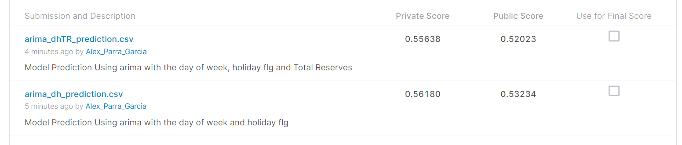
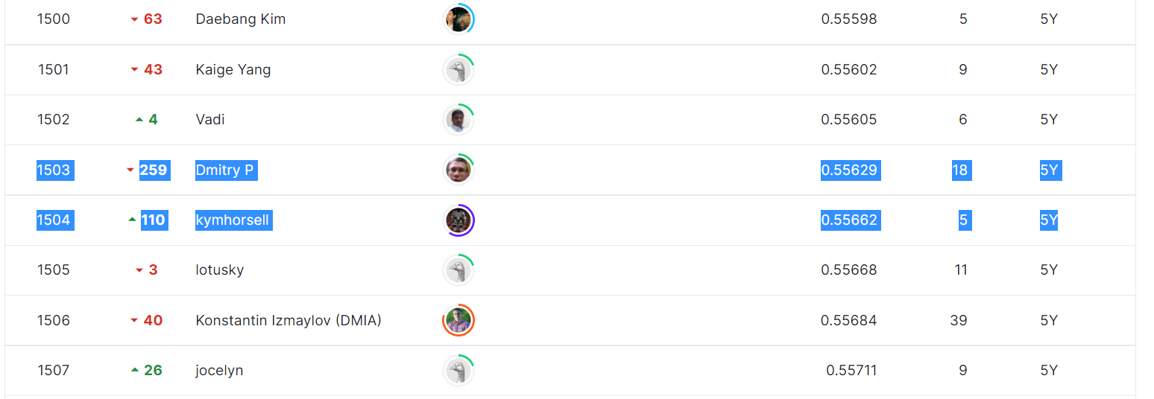

Slide 11
The End

